Slide 1
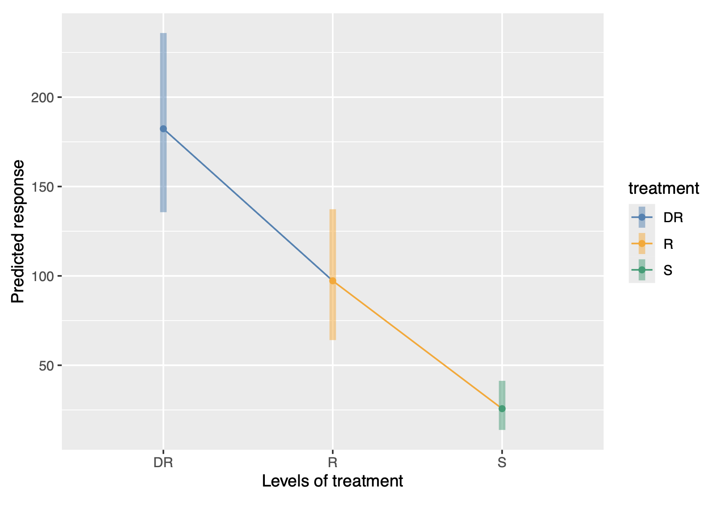
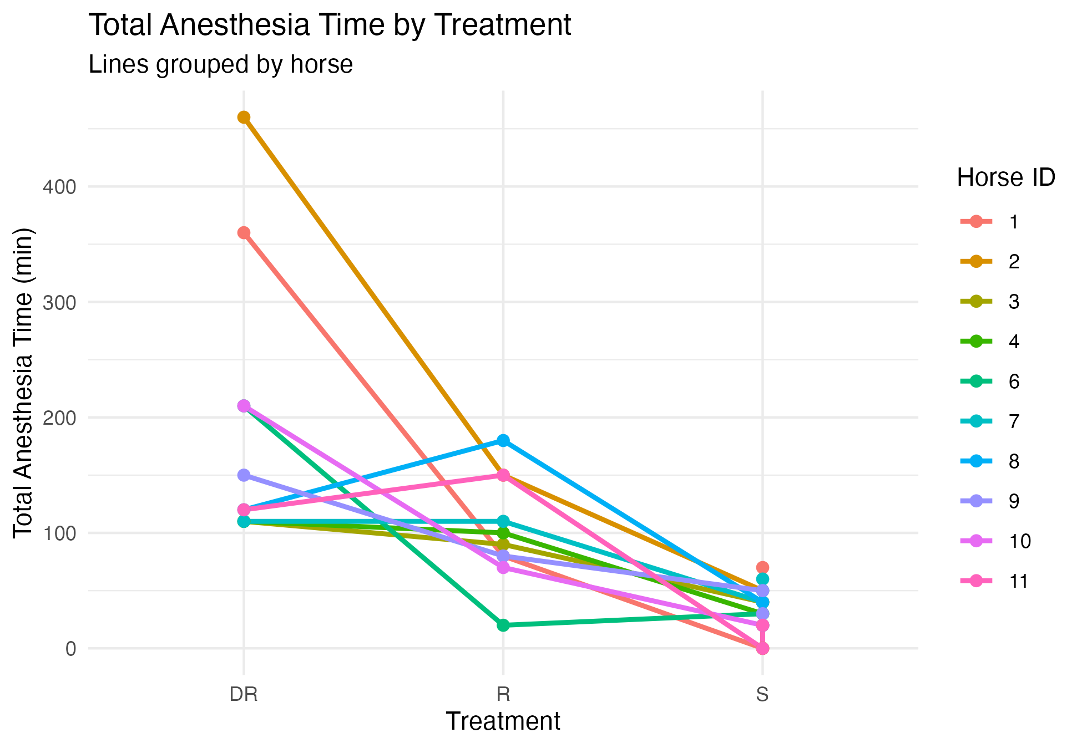
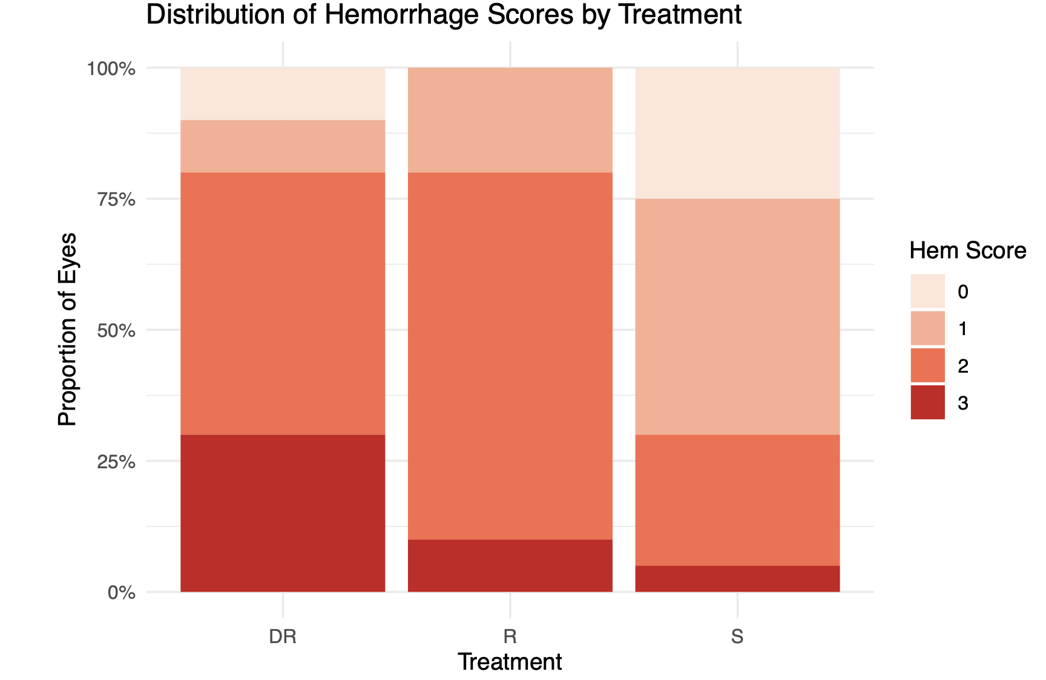
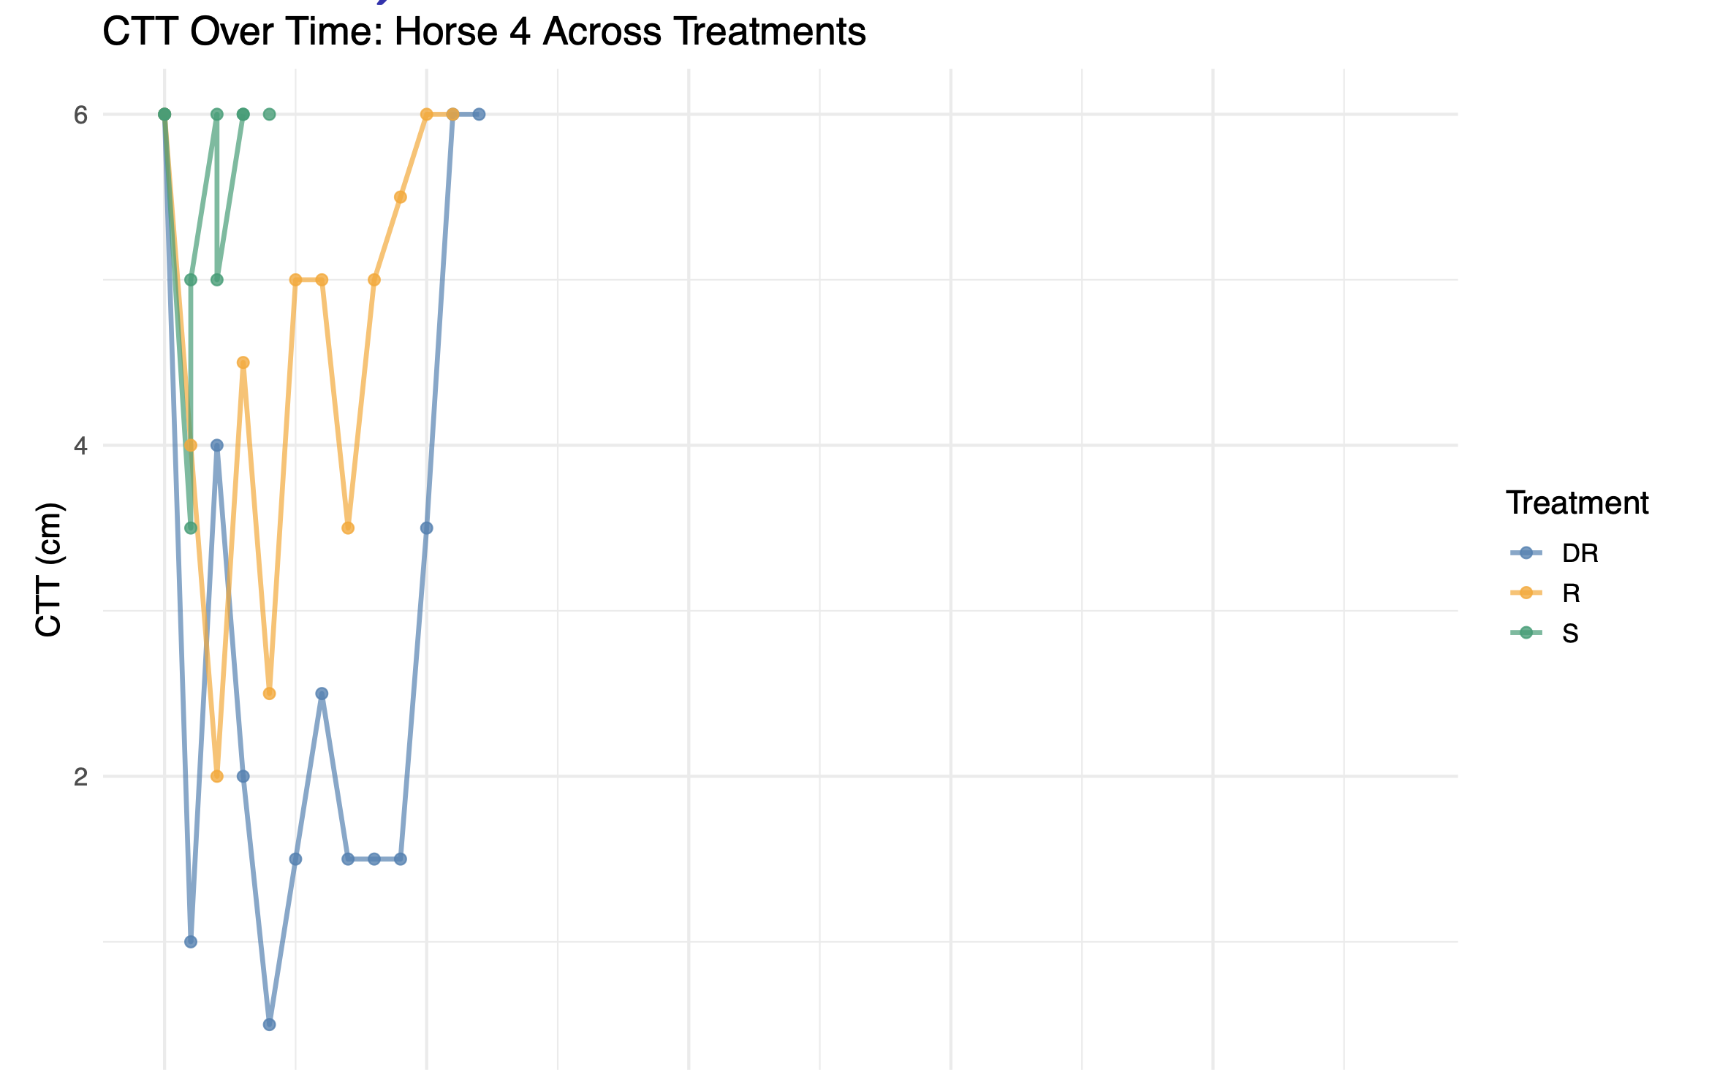

A Statistical Analysis of Equine Corneal Anesthesia
Zach Goldstein, Dr. Ann Hess, Dr. Rachel Hector
Data Science, College of Natural Sciences
Background and Significance
Main Findings
Results and Conclusions
Standing corneal surgery lets veterinarians avoid the ~1% mortality risk that horses face during recovery from full general anesthesia. Success hinges on a long-lasting, painless nerve block. Three subconjunctival protocols were compared in healthy horses:
DR – Ropivacaine + Dexmedetomidine (sedative adjuvant)
Ropivacaine alone (current standard)
Saline placebo
Goal: Determine whether adding a sedative meaningfully extends corneal numbness (Total Anesthesia Time, TAT) while tracking safety via hemorrhage scores.
Adding dexmedetomidine extended median TAT from ~100 minutes (R) to ~150 minutes (DR) (F = 31.1, p < 1e-6). Minimum CTT duration and peak corneal pressure also favored DR (all p > 0.05). The paired Wilcoxon test for DR vs R, however, didn’t favor this (p ≅ 0.076), due to it ignoring between-horse variability. Hemorrhage scores were slightly higher under DR but remained clinically acceptable.
Adding the sedative (DR) extends the surgical window.
Mixed-effects model on √TTA → F(2, 29) = 31.1, p < 1e-6
Back-transformed means: DR ≅ 150 min, R ≅ 100 min,
S ≅ 35 min.
Non-parametric check shows otherwise.
Paired Wilcoxon signed-rank test (DR vs R) showed the same upward trend but did not reach 0.05 significance (p = 0.076); Hodges-Lehman median gained ≅ +38 min.
Hemorrhaging remained similar between DR and R.
DR and R groups shared a comparable spread of hemorrhage scores 0-3, with the majority of eyes falling in the mild 1-2 range.
Time-course plots illustrate the mechanism.
DR maintains lower CTT for longer, while corneal pressure returns rapidly for all groups (see Fig. 3).
Residual and QQ plots confirmed model assumptions; horse-period variance was ≅ 0 and was omitted for parsimony.
Estimated Marginal Means For Total Anesthesia Time
Figure 2. Back-transformed estimated marginal means of total anesthesia time from the mixed-effects model (points) with 95% confidence intervals (bars). DR provides a markedly longer block than ropivacaine alone (R) or saline (S).
Figure 1. Total anesthesia time for each horse under all three treatments. Lines connect the same horse across protocols, illustrating both within-horse consistency and the overall advantage of the dexmedetomidine + ropivacaine (DR) regimen.
Methods/Techniques/Experiments
Design: Two-period crossover, 10 horses, each eye tested twice (20 eye-sessions, opposite eye saline placebo). One week wash-out between sessions.
Measurements: Every 10 minutes until corneal-touch threshold (CTT) returned to baseline measurement twice consecutively; corneal pressure and hemorrhage grade recorded concurrently.
Primary outcome: TAT (minutes).
Statistics: Mixed-effects model with treatment as fixed effect, horse as random intercept; square-root transform for TAT. Tukey-adjusted estimated marginal means (EMMeans) for pairwise contrasts, plus paired Wilcoxon signed-rank test as a distribution-free check.
Figure 4. Stacked bar chart showing the proportion of eyes within each hemorrhage grade (0-3). Scores ≥ 2 are most frequent under DR protocol
0
100
200
300
400
Acknowledgements
Figure 3. Corneal touch-threshold (CTT) recovery for a representative horse (ID 4) under DR, R, and S. Lower CTT values over a longer period under DR demonstrate the extended sensory blockade compared with R and S.
Thanks to the CSU Department of Statistics Undergraduate Research Program and the CSU Veterinarian Teaching Hospital, to Dr. Ann Hess and Dr. Rachel Hector for mentorship, and CURC for this presentation opportunity.
[1] Goldstein Z, Hess A, Hector R. Statistical Analysis of Equine Corneal Anesthesia. College of Natural Sciences, Colorado State University; 2025.
Gonzales G, Betbeze C, Wills R, Eddy A L, Mochal-King C, Fontenot R L. Effects of subconjunctival ropivacaine, liposomal bupivacaine, and mepivacaine on corneal sensitivity in healthy horses. Veterinary Surgery. 2023; 52(7): 1041-1049. doi:10.1111/vsu.13980
Lum E, Murphy P J. Effects of ambient humidity on the Cochet-Bonnet aesthesiometer. Eye. 2018; 32(10): 1644-1651. doi:10.1038/s41433-018-0150-z

